Slide 1
Source of Business Patient Data Analysis
- IMS LRx Database
Through December 2012

Slide 2
Objective
The objective of this study is to provide Merck with monthly Diabetes Market Tracking reports, allowing them to assess patient activity/behaviors in the market over time. This monthly tracking report examines the Diabetes Market products sources of business, with a concentration on the dynamic sources of business which are New Patients, Switching Patients, and Patients that add-on products to their therapy.

Slide 3
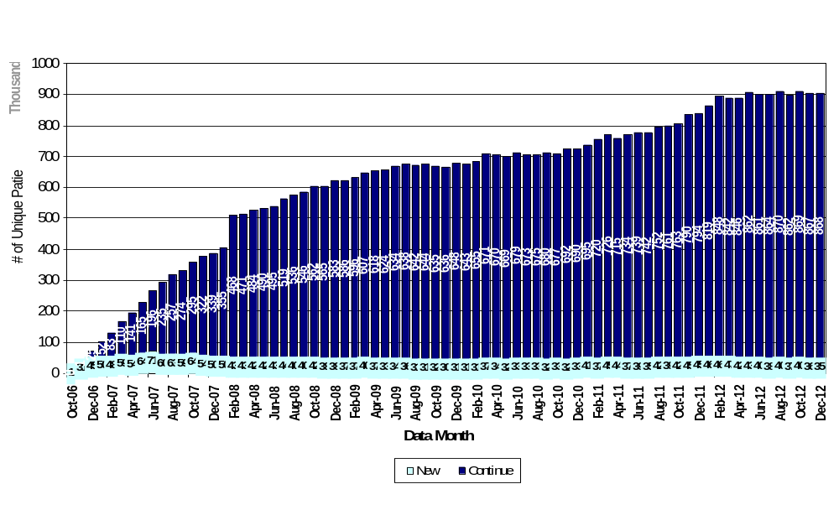
Distribution of current patients on JANUVIA

Slide 4
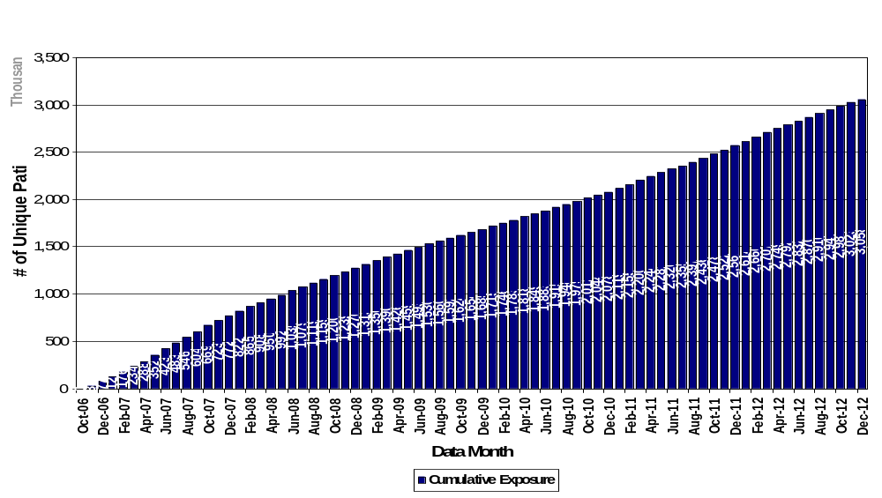
Januvia Cumulative Patient Exposure

Slide 5
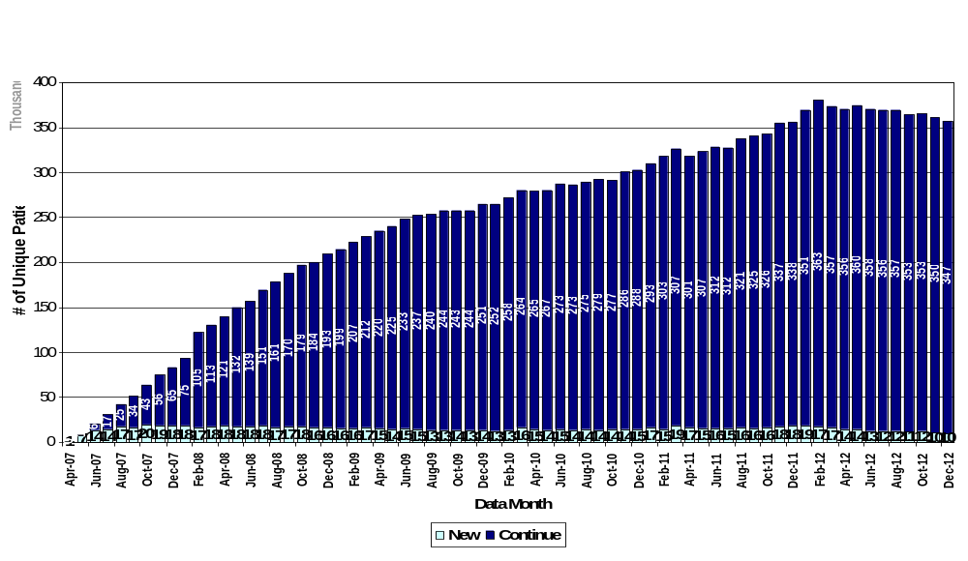
Distribution of current patients on JANUMET

Slide 6
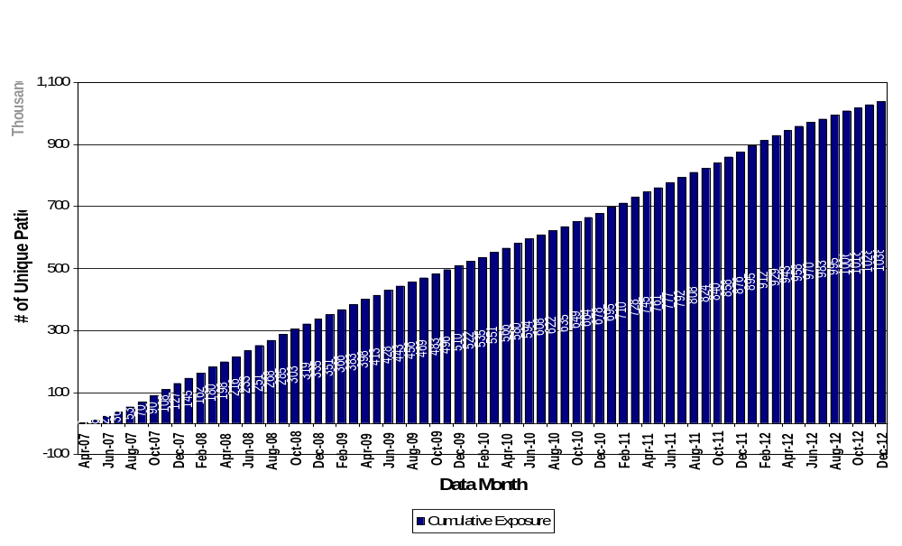
Janumet Cumulative Patient Exposure

Slide 7
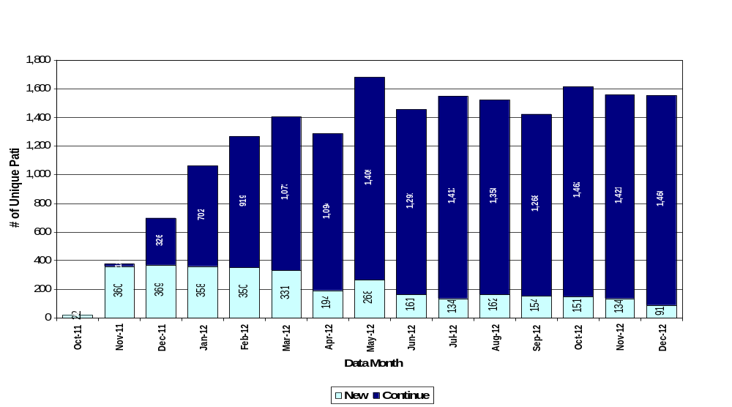
Distribution of current patients on JUVISYNC

Slide 8
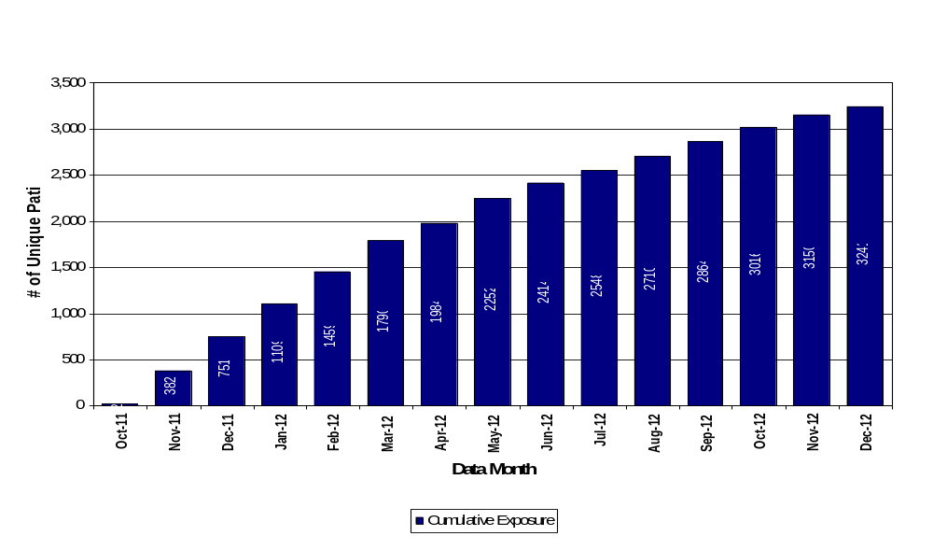
Juvisync Cumulative Patient Exposure

Slide 9
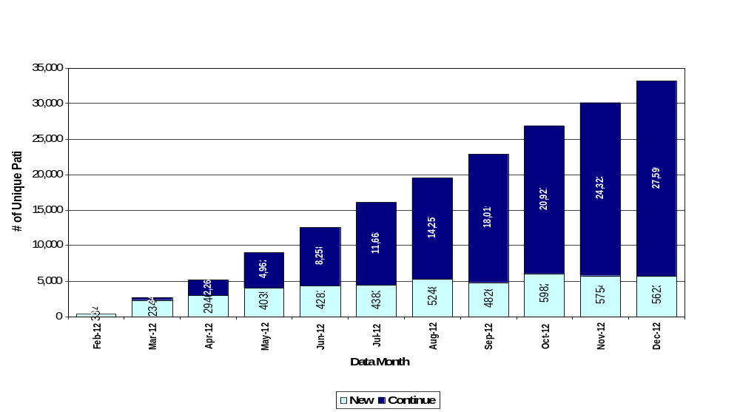
Distribution of current patients on JANUMET XR

Slide 10
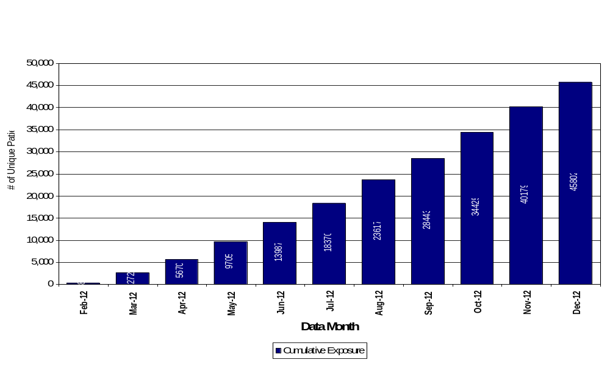
JANUMET XR Cumulative Patient Exposure

Slide 11
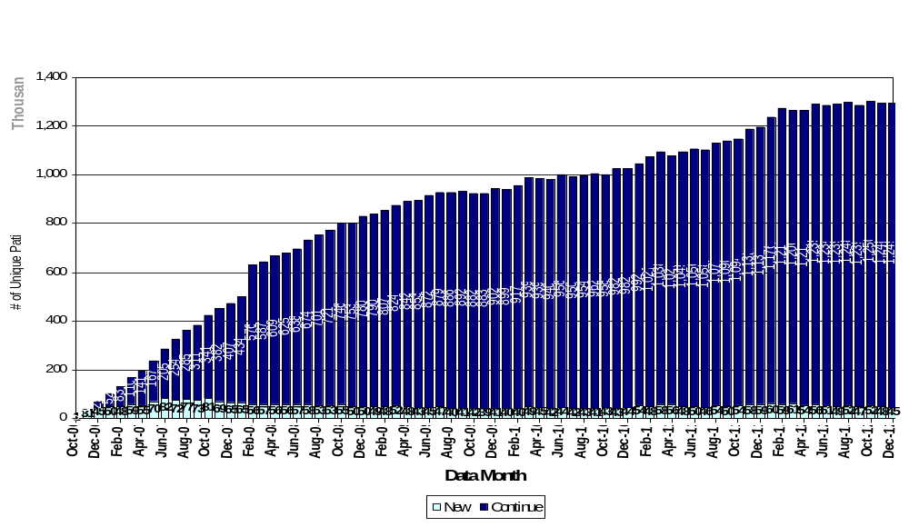
Distribution of current unique patients on SITAGLIPTIN
Note: The counts reported in this slide is unique patient count.

Slide 12
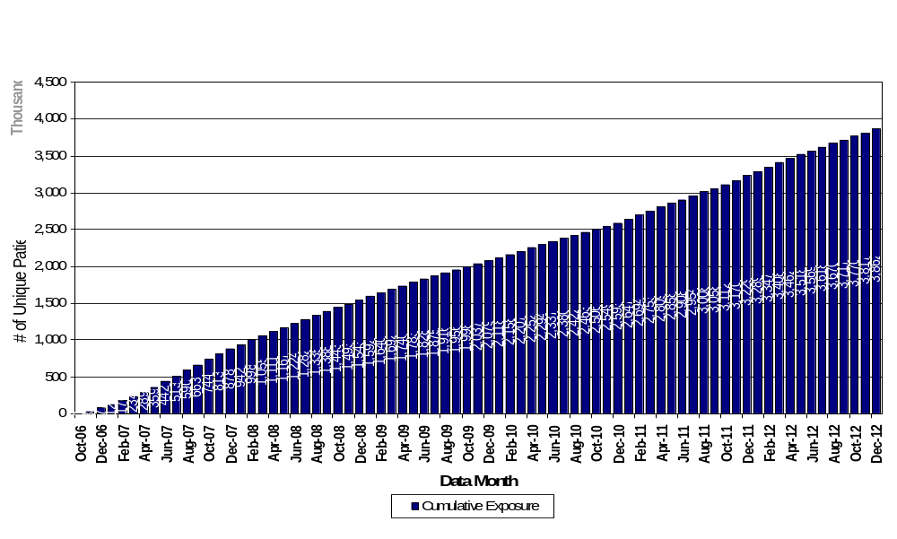
Sitagliptin Cumulative unique Patient Exposure
Note: The counts reported in this slide is unique patient count.

